Slide 1
VACCINE TRACKING-TRANSPARENT
Ester rani d -510520104015
Sudarvizhi s -510520104029
Pavithra p -510520104304

Slide 2
1.INTRODUCTION
1.1PROJECT OVERVIEW
1.2Purpose
2.EXISTING PROBLEM
2.1Problem statement
3.IDEATION AND PROPOSED SOLUTION
3.1Empathy map canvas
4.REQUIREMENT ANALYSIS
4.1Functional requirements
4.2NonFunctional requirements
5.PROJECT DESIGN
5.1Dataflow diagram &user scenarios
6.CONCLUSION

Slide 3
INTRODUCTION
The "Vaccine Tracking - Transparent using Blockchain" project is a groundbreaking initiative in healthcare that addresses the critical challenges of vaccine management and tracking. In response to widespread data inaccuracies, lack of transparency, and counterfeit vaccines, the project leverages blockchain technology to create a secure, transparent, and efficient system for tracking and administering vaccines. Using a strategic combination of Node.js, React, and Ethereum's Solidity, the project creates an immutable ledger and automated smart contract ecosystem that ensures the integrity and security of vaccine-related data. It also provides an intuitive interface for healthcare professionals, patients, and supply chain stakeholders to seamlessly interact with the blockchain network. The project's central goal is to instill renewed trust and transparency in the vaccine supply chain, bolstering patient safety and streamlining regulatory compliance. Through its comprehensive approach to system design, development, testing, deployment, and continuous maintenance, the "Vaccine Tracking - Transparent using Blockchain" project strives to revolutionize healthcare and set a new standard for secure and transparent vaccine management

Slide 4
1.1PROJECT OVERVIEW
The "Vaccine Tracking - Transparent using Blockchain" project is a technology-driven endeavor aimed at redefining the management of vaccines in the healthcare ecosystem. This innovative system combines Node.js, React, and Ethereum's Solidity to establish a blockchain-based ledger and automated smart contracts for secure and transparent vaccine tracking. Through a user-friendly React-based interface, healthcare professionals, patients, and supply chain managers can interact with the blockchain, ensuring immutable and tamper-proof vaccine data. The project spans phases like system design, development, testing, deployment, user training, and continuous maintenance. The expected outcomes include heightened transparency and traceability in the vaccine supply chain, bolstered patient safety, and reduced counterfeit vaccine risks. This holistic solution has the potential to streamline vaccine tracking, building trust in healthcare and enhancing patient safety.

Slide 5
1.2PURPOSE
The purpose of the "Vaccine Tracking - Transparent using Blockchain" project is to develop and implement a robust blockchain-based system that improves the transparency, security, and traceability of vaccines within the healthcare supply chain. This system is designed to address critical issues such as inaccuracies in vaccine data, patient safety concerns, and the risk of counterfeit products. By leveraging technologies like Node.js, React, and Ethereum's Solidity, the project aims to create an immutable ledger and smart contract ecosystem that benefits healthcare professionals, patients, and supply chain stakeholders. Ultimately, the project's purpose is to enhance public health by ensuring the authenticity and reliability of vaccines, while also simplifying vaccine tracking and administration processes.

Slide 6
2.EXISTING PROBLEM
In the healthcare industry, a pressing issue is the reliance on outdated manual record-keeping and data management systems, which gives rise to a range of critical challenges. These challenges encompass
1. Data Inaccuracies: The manual nature of record-keeping results in human errors, introducing inaccuracies into vaccine administration records. These inaccuracies pose a significant risk to patient safety and public health.
2. Lack of Transparency: Both patients and healthcare professionals often grapple with a lack of transparency into the vaccine supply chain. This deficiency in transparency gives rise to concerns about the authenticity and safety of vaccines.

Slide 7
3. Counterfeit Vaccines: The current system exhibits vulnerabilities that permit counterfeit vaccines to infiltrate the supply chain. This not only endangers public health but also undermines the reputation of pharmaceutical companies.
4. Time-Consuming Processes: Healthcare professionals expend substantial amounts of time on data entry and record-keeping, diverting their attention from patient care and other mission-critical tasks.
5. Regulatory Compliance Challenges: Public health regulators encounter significant challenges in their quest to ensure compliance and data accuracy, due to the potential for data manipulation. primarily

Slide 8
2.2Problem statement
In the healthcare sector, specifically regarding vaccine tracking and administration, the existing manual record-keeping system is plagued by inaccuracies, lack of transparency, and susceptibility to counterfeit vaccines. These challenges compromise patient safety and public health. Healthcare professionals spend excessive time on data entry, and regulatory compliance is hindered by potential data manipulation. Therefore, there is an immediate need for a comprehensive, secure, and transparent solution to modernize vaccine tracking and administration, ensuring data accuracy, enhancing patient safety, and boosting regulatory compliance. The "Vaccine Tracking - Transparent using Blockchain" project aims to address this pressing problem by implementing a blockchain-based system leveraging Node.js, React, and Ethereum's Solidity for smart contracts.

Slide 9
3.IDEATION AND PRPOSED SOLUTIONS
3.1EMPATHY MAP CANVAS

Slide 10
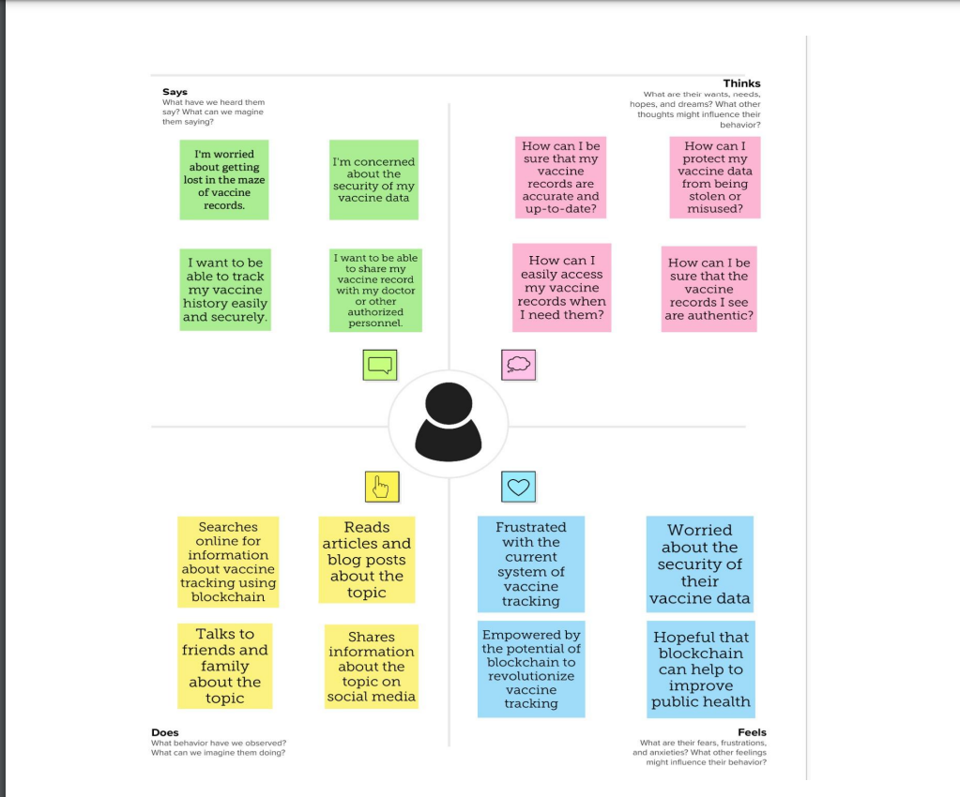

Slide 11
4.REQUIREMENT ANALYSIS 4.1functional requirements
User management is a critical functional requirement for the "Vaccine Tracking - Transparent using Blockchain" project. It involves a set of essential features and capabilities to effectively manage users interacting with the system. The primary functional requirements for user management include:
1. User Registration: - The system should allow users to create accounts by providing necessary information, including username, password, and, optionally, additional user-specific details.
2. User Authentication:- Users must be able to authenticate their identity through secure methods, such as passwords or multi-factor authentication, to access the system

Slide 12
REQUIREMENT ANALYSIS
3. User Authorization:- The system should support role-based access control, ensuring that users are granted appropriate permissions based on their roles or responsibilities.
4. User Profile Management: - Users should have the capability to update and manage their personal information, preferences, and settings within the system.
5. User Access Control: - The system should monitor user activities, track login sessions, and enforce access control policies to ensure that users only access authorized features and data.
6. Password Reset and Recovery:- Users should have the option to reset their passwords or recover their accounts in case of forgotten credentials, while adhering to a secure process for identity verification.
7. User Deactivation and Removal:- The system must provide the means to deactivate or delete user accounts when they are no longer needed or upon user request. Deactivation should restrict access, while removal permanently deletes accounts.

Slide 13
4.2NonFunctional requirements
1. Security: - Data Security: Ensure the confidentiality, integrity, and availability of sensitive user data and vaccine-related information through robust encryption and access controls. - Authentication and Authorization: Implement strong user authentication and authorization mechanisms to protect against unauthorized access. - Protection Against Cyber Threats: The system must be designed to defend against various cyber threats, including data breaches and malicious attacks.
2. Scalability: - The system should be scalable to accommodate a growing number of users, transactions, and vaccine data without compromising performance.

Slide 14
3. Performance: - The system should provide responsive and efficient user management functions to minimize latency and ensure a smooth user experience.
4. Reliability: - The system must be highly reliable, with minimal downtime, to ensure uninterrupted access for users.
5. Usability: - The user management interface should be intuitive and user-friendly, requiring minimal training for users to navigate and perform tasks.
6. Compliance: - Ensure compliance with relevant data protection regulations (e.g., GDPR or HIPAA) and healthcare industry standards for data privacy and security.
7. Interoperability: - The system should be designed to integrate seamlessly with other healthcare systems, such as electronic health records (EHRs) or pharmacy databases, to ensure the smooth exchange of information.

Slide 15
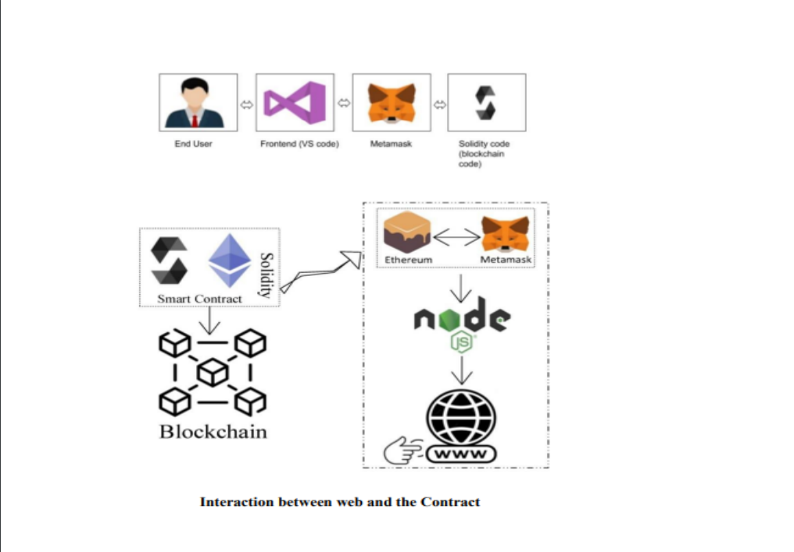
5.PROJECT DESIGN 5.1DATAFLOW DIAGRAM

Slide 16
Patient Registration and Verification:- Scenario: A patient accesses the web application, registers an account by providing personal information, and verifies their identity. - Data Flow: User Interface → Blockchain Network → Smart Contracts → Database - Actions: User registration data is processed, verified, and stored in the blockchain and database.
2. Vaccine Verification by Healthcare Professional: - Scenario: A healthcare professional logs in, scans a vaccine QR code to verify its authenticity, and updates the patient's vaccine record. - Data Flow: User Interface → Blockchain Network → Smart Contracts → Database - Actions: The healthcare professional's actions are recorded on the blockchain, and the vaccine record is updated.
3. Supply Chain Monitoring:- Scenario: A supply chain manager logs in to monitor vaccine shipments, reviews smart contract data, and generates reports on vaccine logistics.

Slide 17
7.CONCLUSION
Vaccines are among the most safe and effective public health interventions to prevent serious disease and death. Because of the success of vaccines, most Americans today have no firsthand experience with such devastating illnesses as polio or diphtheria. Health care providers who vaccinate young children follow a schedule prepared by the U.S. Advisory Committee on Immunization Practices. Under the current schedule, children younger than six may receive as many as 24 immunizations by their second birthday. New vaccines undergo rigorous testing prior to receiving FDA approval; however, like all medicines and medical interventions, vaccines carry some risk National Academies of Sciences, Engineering, and Medicine. 2013. The Childhood Immunization Schedule and Safety: Stakeholder Concerns, Scientific Evidence, and Future Studies. Washington, DC: The National Academies Press.

